Slide 1


Quantum Computers are
coming for our privacy
AND WHAT WE CAN DO ABOUT IT
Richard T. Carback III
Quip Network
@rcarback
June 2026 | Blockspati
https://quip.network
Richard T. Carback III | @rcarback | https://carback.us

Slide 2

TLDW: switch to orchard, yesterday. Be prepared to upgrade, quickly

Slide 3

Cryptographically Relevant Quantum Computers (CRQCs) can compute discrete logs efficiently
Both ECDLP (Used by Zcash and most crypto) and RSA rely on discrete log for security
Blockspati | Berlin | 2026
Richard T. Carback III | @rcarback | https://carback.us

Slide 4

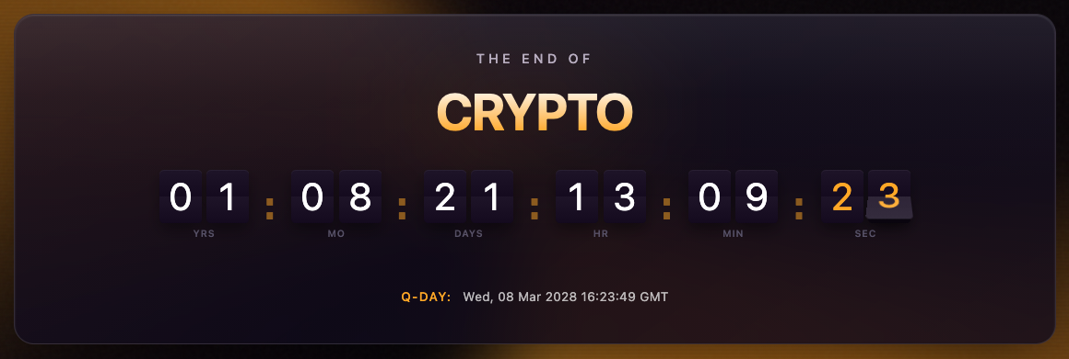
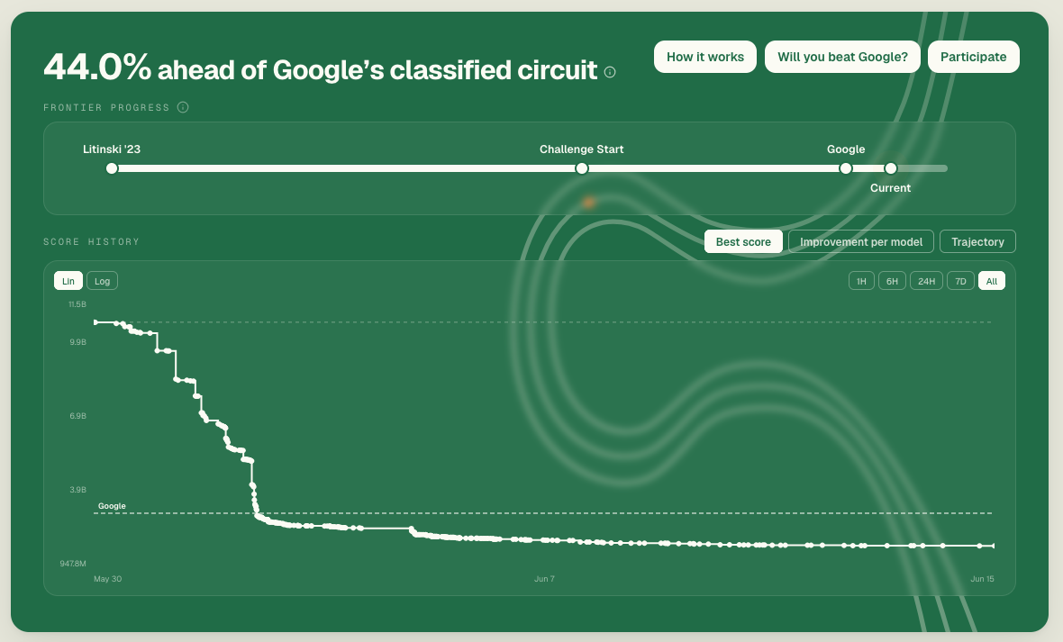
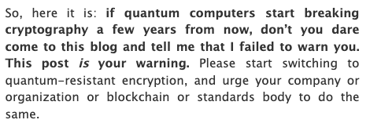
The threat is imminent, maybe as soon as ~2 years away
https://ecdsa.fail/
https://quantumdoomclock.com
Scott Aaronson (CRQC’s greatest skeptic)

Slide 5

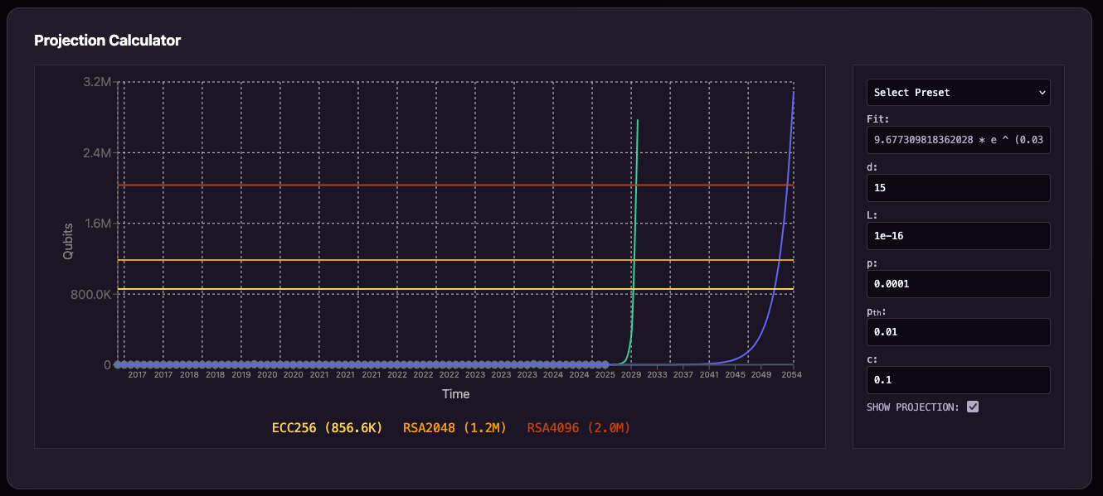
Blockspati | Berlin | 2026
Richard T. Carback III | @rcarback | https://carback.us/

Slide 6
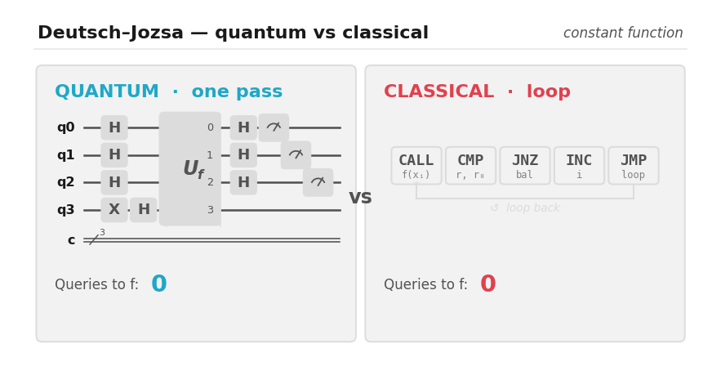
But… How?
Example: a black box computes f : {0,1}ⁿ → {0,1}, promised to be exactly constant or exactly balanced. Decide which.
CONSTANT
Same output bit for every input — all 0s or all 1s.
BALANCED
Output is 0 on exactly half the inputs, 1 on the other half.
QUANTUM 1 query
A single evaluation of f decides it with 100% certainty. An exponential separation in the query model.
CLASSICAL 2^n/2 + 1
evaluations to be certain — exponential in n. Half the inputs can agree and still leave it undecided.

Slide 7

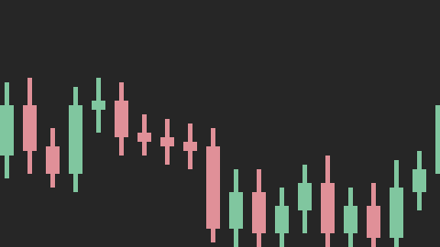
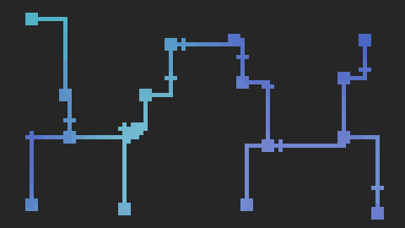

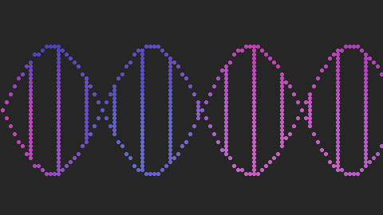
This is going to change the world
● FINANCE
+ LOGISTICS
● INDUSTRIAL
■ SCIENCE & BIOTECH
Materializing alpha in modern finance
Master the complexity of global supply chains
Engineering the future with quantum precision
Unlocking patterns in the chaos
Portfolio allocation, risk modeling, and best execution on quantum processors — more optimal answers, faster than GPU clusters.
Routing, inventory, and demand forecasting across constraints that stall classical solvers.
De-risk R&D and get more from physical assets — scheduling, materials simulation, and design optimization.
A decentralized lab for combinatorial optimization, stochastic modeling, and molecular discovery.

Slide 8
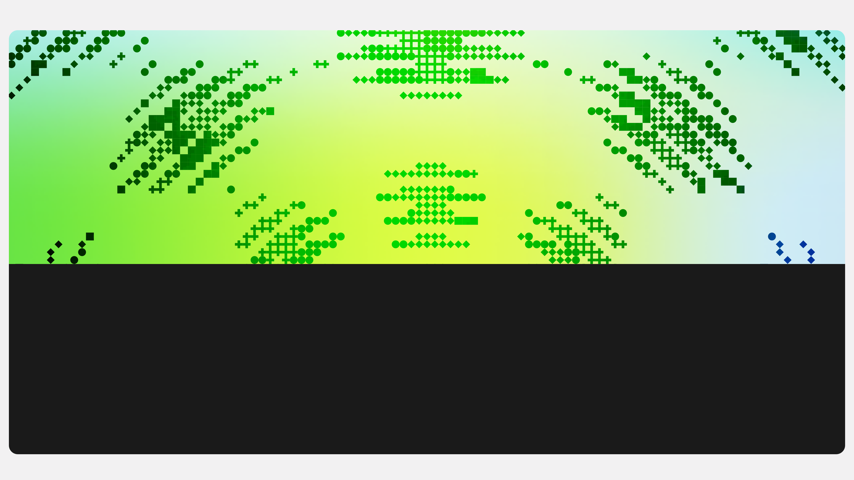
Harvest Now, Decrypt Later
(HNDL)
Blockspati | Berlin | 2026
Richard T. Carback III | @rcarback | https://carback.us

Slide 9

Most privacy crypto is pwned
CATEGORY | PRIMITIVES (EXAMPLES) | DL / ECC EXPLOITED | WHAT QUANTUM BREAKS
Proof Systems | Schnorr / Sigma; Bulletproofs (Monero range proofs); Groth16 / PLONK (Zcash Sapling, zk-rollups) | Pedersen commitments + inner-product argument; KZG over pairings; group homomorphism for succinctness | Commitment binding → forged / inflated proofs; knowledge-soundness; trusted-setup toxic-waste recovery
Message Anonymizers | Tor ntor (X25519); Sphinx / Loopix (Katzenpost); ElGamal re-encryption mixnets + verifiable shuffle (e-voting) | ECDH per-hop keys; DH NIKE; ElGamal homomorphic re-encryption | Session keys (HNDL → retroactive de-anon); shuffle soundness
Anonymous Authentication | OPRFs (Privacy Pass, OPAQUE); blind signatures; anonymous credentials (BBS+, CL/Idemix, Coconut); VRFs (ECVRF) | DH VOPRF; DL / pairing signatures with efficient ZK proof-of-possession | Unlinkability; unforgeability; holder anonymity
Confidential Ledgers | Monero (CLSAG, RingCT, stealth addrs); Zcash Orchard (Halo2 / Pasta); Mimblewimble (Grin, LTC MWEB) | Pedersen homomorphism; ring signatures; ECDH stealth addresses | Amount binding → inflation; anonymity set → de-anon; key recovery
MPC / Threshold | DH-based OT; threshold ECDSA / BLS, DKG (FROST); Feldman / Pedersen VSS | DL commitments for share verifiability; DH for oblivious transfer | Key / share recovery; commitment binding
Encrypted Aggregation | Secure aggregation (federated learning); Prio; additively-homomorphic ElGamal | DH pairwise masks; additive ElGamal homomorphism | Individual contributions exposed

Slide 10

And ZCash? It’s complicated..
Transparent T1 / T3 · UNSHIELDED
Sprout LEGACY · DEPRECATED
THEFT
THEFT COUNTERFEIT
Primitives ECDSA / secp256k1 (P2PKH, P2SH)
Primitives BCTV14 / Groth16 · SHA-256
Pubkey sits behind two hash layers until first spend, which is the same as Bitcoin. P2SH hides constituent keys only until the redeem script is revealed. Never reuse a t-address.
Trusted-setup toxic waste is recoverable (partly even classically) → counterfeiting.
Sapling SHIELDED
Orchard (NU5) SHIELDED
THEFT PRIVACY COUNTERFEIT
THEFT PRIVACY COUNTERFEIT
Primitives RedJubjub · ECDH · Pedersen · Groth16 / BLS12-381
Primitives RedPallas · ECDH · Sinsemilla · Halo 2 (no trusted setup)
Spend key blinded per spend, but a known address → viewing-key recovery + retroactive decryption; Pedersen binding and Groth16 soundness both fail. Also trusted setup.
NU5 is more private, as the spend pubkey is never on chain in the clear and nullifiers are PQ-hiding.
Hashing & PoW face only Grover — not existential

Slide 11
Orchard NU7 Improvements help
ZIP 2005: Recoverability
Tachyon: Oblivious Sync
PROTECTS FUNDS
PROTECTS PRIVACY
Note commitments are post-quantum binding — funds can be frozen and recovered into a future PQ-sound pool with preserved privacy.
Re-architects shielded transactions with proof-carrying data + oblivious synchronization. Removes the on-chain note ciphertext → a future attacker who knows your address can no longer decrypt past amounts/memos → full post-quantum privacy.
Status & timeline (as of 17 Jun 2026): NU7 testnet (rc0) went live 22 May 2026 (ephemeral); mainnet not yet activated, maybe late 2026. ZIP 2005’s consensus enforcement rides on the deferred v6 transaction format; near-term NU7 work is now the Ironwood soundness fix (~late Jul 2026), pushing v6 / ZIP 2005 enforcement later. Tachyon: targeted for a later, post-NU7 upgrade. IOW: the Apr-2025 “within a year” goal has slipped.
Sources: zips.z.cash/zip-2005 · seanbowe.com · IACR ePrint 2025/2031 · tachyon.z.cash · forum.zcashcommunity.com (NU7-rc0).

Slide 12
Orchard preserves privacy, but a CRQC still breaks the proof system.

Slide 13

Privacy is not just the crypto
Pubkeys are secrets now
Shor turns an exposed public key into the private key. Stop reusing addresses — the first spend reveals it forever.
Isolation
Compartmentalize keys, identities, and metadata so one broken primitive can't cascade. Contain the blast radius.
Pseudonyms
Unlinkability is perishable — a future CRQC can de-anonymize harvested traffic. Rotate identities; never link them.
Upgrade
Crypto-agility is the only durable defense. Be ready to rotate algorithms and move funds into PQ-sound pools fast.
Minimize & expire
Data never sent or stored can't be harvested. Emit less, keep less, and use ephemeral wallets.
“The enemy knows the system.”
— Claude Shannon’s maxim (1949), formalizing Kerckhoffs’s principle (1883)

Slide 14

Cryptographers are working on solutions
CATEGORY | EFFICIENT-PQ ALTERNATIVE | EFFICIENT-PQ VIABILITY
Proof Systems | Lattice ZK (LaBRADOR ~60–70 KB, Greyhound); lattice SNARKs | POOR–MODERATE ●●○○○ 10×–1000× larger; loses the succinct + transparent + homomorphic trifecta. Hash-based STARKs are the PQ-safe exception, at larger proof size / heavier prover.
Message Anonymizers | Hybrid X25519+ML-KEM (Tor); KEM-Sphinx; lattice shuffle proofs | MODERATE ●●●○○ KEM hybrids work for transport; NIKE-based Sphinx is awkward (PQ NIKEs scarce; CSIDH slow); lattice shuffles hit splitting-ring soundness bugs.
Anonymous Authentication | Lattice VOPRF; lattice blind sig (22 KB); lattice / zkDilithium creds (85–175 KB) | POOR ●○○○○ Hardest tier: proofs-of-possession hundreds of KB, OPRFs MB-scale (isogeny ~9 MB). No lift-and-shift.
Confidential Ledgers | Lattice ring sigs (MatRiCT, Raptor) — research-grade | POOR ●○○○○ Entire designs lean on g^a·g^b = g^(a+b); retroactive de-anon is irreversible.
MPC / Threshold | Threshold ML-DSA; lattice OT (+ OT-extension); SIS commitments | MODERATE–GOOD ●●●●○ OT-extension and the Shamir core migrate cleanly; threshold lattice signing is still hard.
Encrypted Aggregation | LWE / LPN additive HE; key-homomorphic PRFs | MODERATE–GOOD ●●●●○ Lattice / LPN additive homomorphism handles sums; needs noise / overflow management.
VIABILITY ●●●●● GOOD ●●●○○ MODERATE ●○○○○ POOR

Slide 15



Questions?
rick@quip.network
https://quip.network
@quipnetwork
https://quantumdoomclock.com
https://quip.network
Richard T. Carback III | @rcarback | https://carback.us

